Slide 1
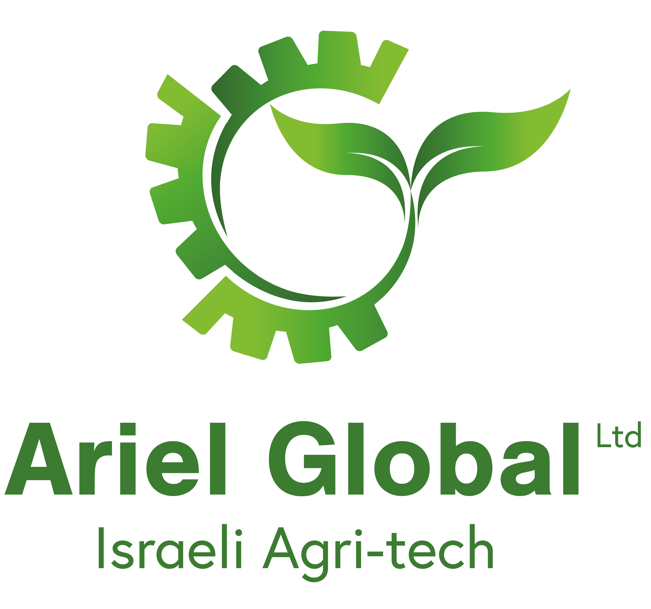
Agriculture
He shall cause them that (in days to) come of Jacob to take root: Israel shall blossom and bud, and fill the face of the world with fruit.
Isaiah 27:6

Slide 2
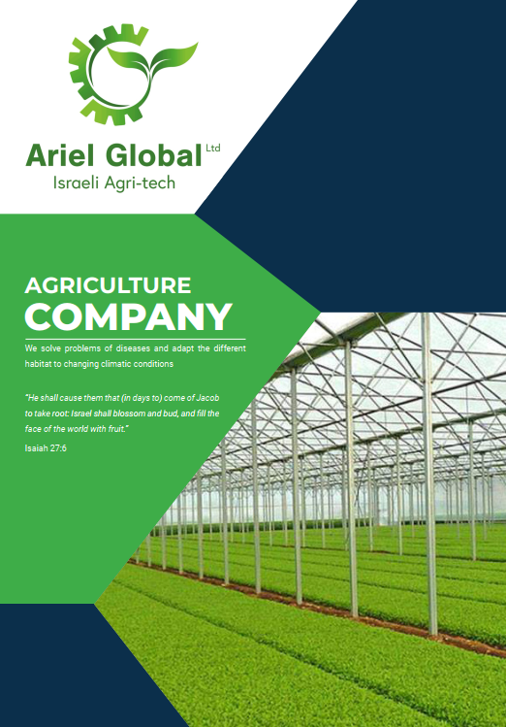
About Us
Ariel Global Links, Ltd. Israeli legally registered Agriculture Company opened since year of 2009, Located in Poriya, North Israel. The company is engaged in a variety of agricultural sectors in the global market, while providing practical solutions and training to local farmers in India in general and construction projects in the various areas listed below.
For Global going to expand in to agriculture Industrial, we have in Agriculture high and advance technology in Israel world famous and we produce from the desert best harvest. India and Japan have rich and healthy land, this way we launch in India and Japan such an Agriculture Projects and we can solve problems of diseases and adapt the different habitat to changing climatic conditions within use our high technology Which includes extensive knowledge, experience and irrigations system with small quantity of water against lack of rain and global water.
As of today, we are in the process of establishing a "Mini Israel" project in the field of agriculture in India and are in the process of establishing a mango project in Japan.

Slide 3
Our Activity
Greenhouses
In door projects
Hydroponics / Aquaponics
Fruit orchards
Dairy farms & Cattle Feed.
Greenhouses with or without climate control
Growing vegetables and fruits in buildings
NFT, PVC Pipes, Growing ponds.
combined with vegetable, fish and shrimps
Pomegranate, Avocado, Apple, Melon, Mango and Field crops
Dairy Farm in Israel Technology.
Special Formula for raising milk yield.

Slide 4
Our Activity
Agro Tour to Israel
Import \Export
Research and development
6 nights 5 days Agricultural Tourism in Israel
Pomegranate, Avocado, Apple, Melon, Mango, Vanilla, Spices
Research and development of Israeli and Indian varieties

Slide 5
Fruit orchards
Pomegranate, Avocado, Apple, Melon, Mango and Field crops

Slide 6
The Avocado
Avocados are known internationally for their high vitamin content and versatility for use in different dishes. Avocado consumption has seen high growth in different world markets, given the trend to consume products with natural fat, increased knowledge of its properties and the perception that it is a healthy food. The greatest demand in the world market is for the Hass and Fuerte varieties.
Demand for avocados is currently concentrated in developed countries. The United States and European markets are the largest consumers of this fruit, with average per capita consumption of 2.5 kg, and 0.56 kg respectively.
It is estimated that total consumption of avocados in the United States reached 750,000 tons in 2013, with average annual growth (CAGR) of 9.2%, while consumption in the European region totaled 290,000 tons in the June 2013-May 2014 season.

Slide 7
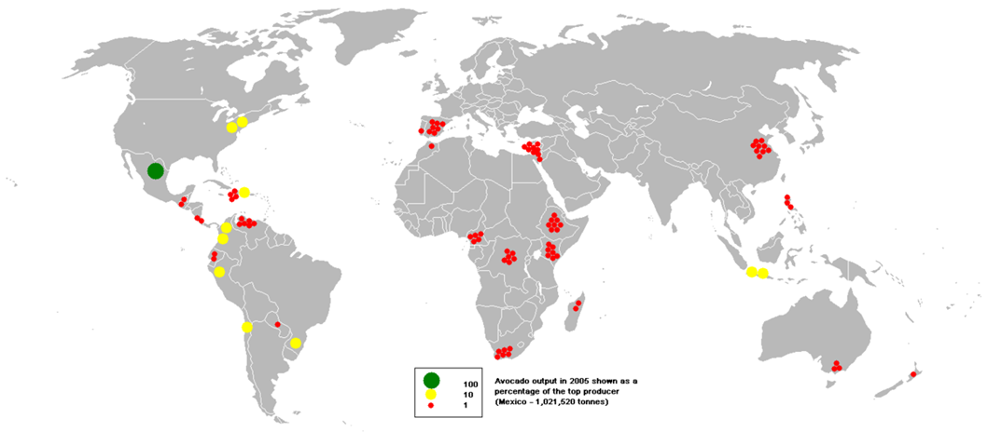
Growing avocados around the world
Mexico
Israel
Spain
USA
Central Africa
South Africa
Australia
China
Latin America

Slide 8
Avocado number of varieties, the varieties grown in Israel:
Avocado number of varieties, the varieties grown in Israel:
Ettinger, a large preliminary strain smooth and shiny shell.
Puerta, a mid-season variety, rugged, more than Agassi.
Haas, species second half of the harvest season, with a nutty flavor. Very rough bark, scaly, and ripe fruit turns black.
Pinkerton, a mid-season variety, rough and dark green in color, common in the plantations of the Jordan Valley.
Galilee, ripens end of August. Narrow, elongated shape. In 2009, the Council recommended that the plants do not buy the fruit before the official season because then fails to mature properly.
Nabala vein, late-season varieties, and large round ball. Enter Reed lasts all summer on trees and irrigation regime is right to keep it on the tree until September.

Slide 9
Table of Total gorse income in 25 acres in INR
Year | Harvest in MT per Acre | Quantity for 25 Acre (MT) | Average of market price per MT (assumed) | Total Income in INR
0 | 0 | 0 | 0 | ------------
1 | 0 | 0 | 0 | -----------
2 | 0 | 0 | 0 | -----------
3 | 4 | 100 | 1,800 / - USD | 180,000 / - USD
4 | 6 | 200 | 1,800 / - USD | 360,000 / - USD
5 | 12 | 300 | 1,800 / - USD | 540,000 / - USD
6 | 12 | 300 | 1,800 / - USD | 540,000 / - USD
7 | 12 | 300 | 1,800 / - USD | 540,000 / - USD
8 | 12 | 300 | 1,800 / - USD | 540,000 / - USD
9 | 12 | 300 | 1,800 / - USD | 540,000 / - USD
10 | 12 | 300 | 1,800 / - USD | 540,000 / - USD

Slide 10
Expenses calculation for Avocado (cost per acre) Minimum project 25 acre (10Hectare), 240 tree per acre
Description | Year 0 | Year 1 | Year 2 | Year 3 | Year 4 | Year 5 | Year 6 Until 20
Crops |  |  |  | 4 | 6 | 12 | 12
Income from Crops 1. |  |  |  | $ 7,200 | $ 14,400 | $ 21,600 | $ 21,600
Expense for projects
2 | $ 4,095 | $ 1,605
3 | ---- | $ 536 | $ 536 | $ 536 | $ 536 | $ 536 | $ 536
4 | ---- | $ 300 | $ 611 | $ 1,307 | $ 2,336 | $ 2,336 | $ 2,336
5 | ---- | $ 200 | $ 200 | $ 285 | $ 285 | $ 285 | $ 285
6 | ---- | $ 291 | $ 291 | $ 291 | $ 291 | $ 291 | $ 291
7 | ---- | $ 243 | $ 286 | $ 675 | $ 1,905 | $ 1,905 | $ 1,905
8 | $ 228 | $ 228 | $ 228 | $ 228 | $ 228 | $ 228 | $ 228
9 | $ 20 | $ 117 | $ 233 | $ 823 | $ 1,099 | $ 1,558 | $ 1,558
10 | $ 2,515 | $ 2,443 | $ 2,378 | $ 881 | $ 881 | $ 881 | $ 881
Total expenses per Acre | $ 6,858 | $ 5,963 | $ 4,763 | $ 5,026 | $ 6,680 | $ 8,020 | $ 8,020
Trial Balance Points in INR for 25acre ( 10 Hectare)
Description | Year 0 | Year 1 | Year 2 | Year 3 | Year 4 | Year 5 | Year 6 Until 20
Total gorse income from 25 Acre. |  |  |  | $ 180,000 | $ 360,000 | $ 540,000 | $ 540,000
Total expenses for 25 Acre | $ 171,450 | $ 149,075 | $ 119,075 | ₹ 125,650 | ₹ 167,000 | ₹ 200,500 | ₹ 200,500
The net balance | $ 439,600 |  |  | ₹ 54,350 | ₹ 193,000 | ₹ 395,500 | ₹ 395,500
A profit and loss | ₹ -171,450 | ₹ -320,525 | ₹ -439,600 | ₹ -385,250 | ₹ -192,250 | ₹ 203,250 | ₹ 598,750

Slide 11
The Pomegranate
Slowly but steadily, pomegranates are attracting interest, now that consumers
Worldwide see the pomegranate as a “super fruit” due to its high nutritional value and health benefits. It has gone from being seen as a fruit that is difficult to eat to a highly sought after super fruit.
The major markets for pomegranate are Europe, the United States and Canada, followed by India, Malaysia, Japan and the United Arab Emirates, among others. In these markets, the popularity of this fruit has resurged in the last ten years and demand has increased, due to greater interest among consumers in purchasing healthy, nutritious products.
Just in 2013, an additional 67 thousand tons were shipped to the European market, which is considered to be the best-consolidated pomegranate market.

Slide 12
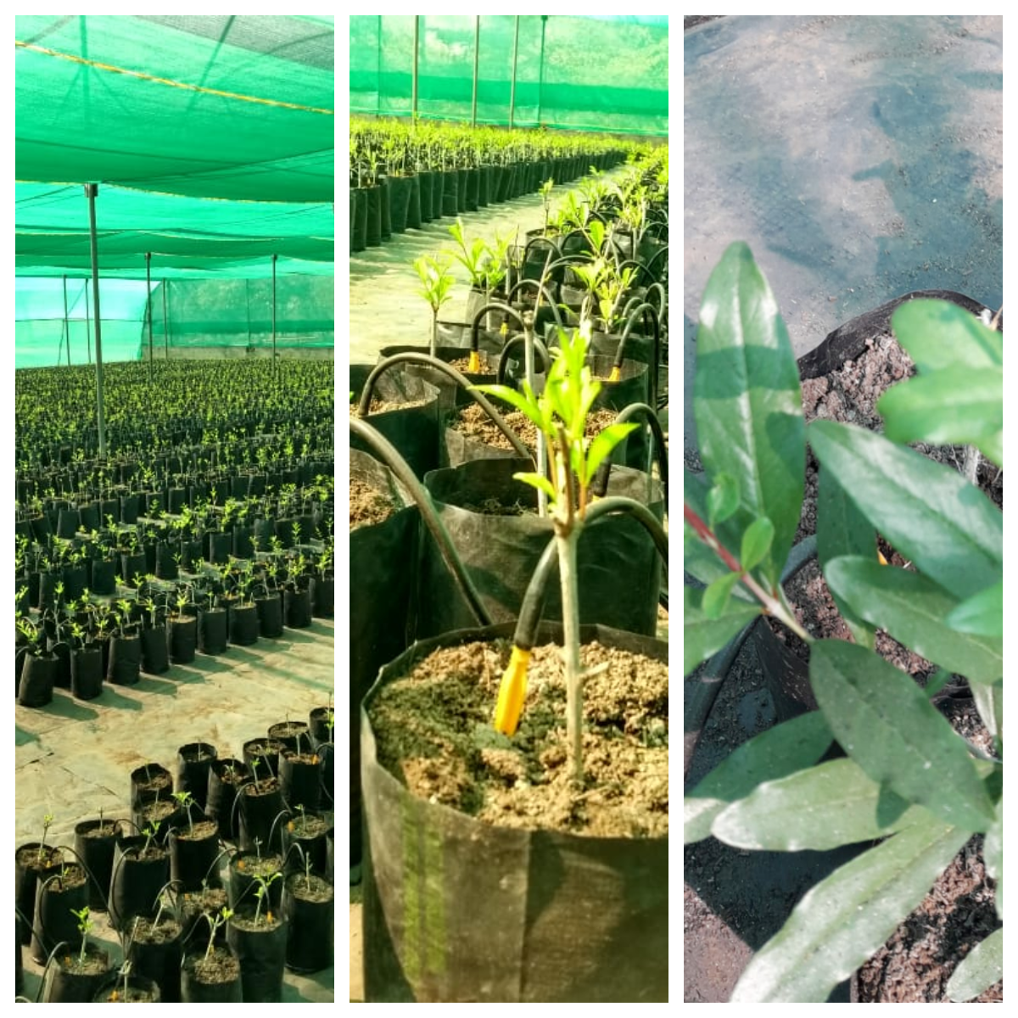
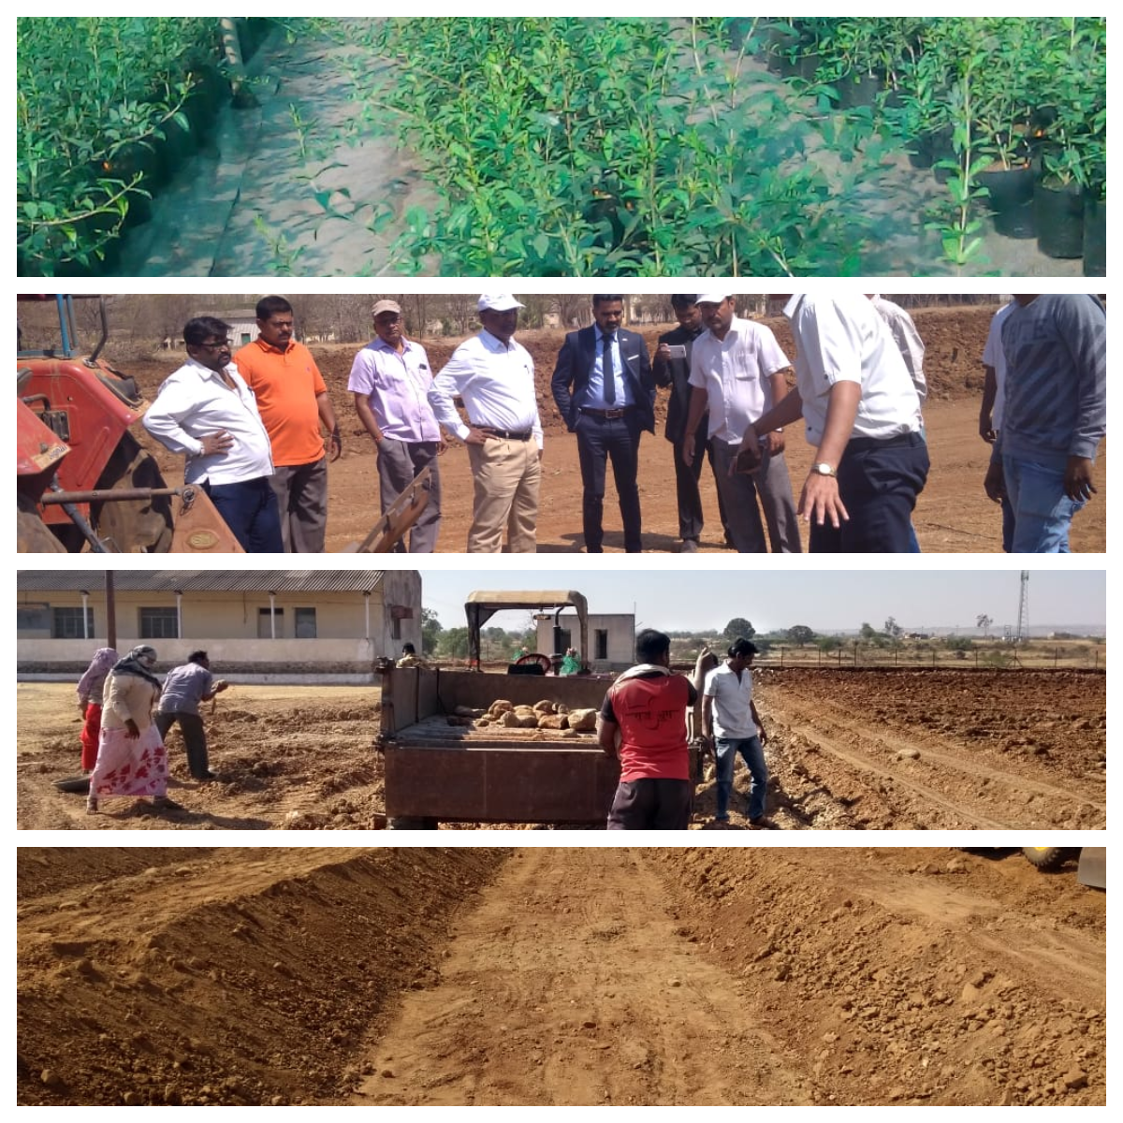
Our Pomegranate project in JAT, Maharashtra

Slide 13
Table of Total gorse income in 25 acres
Year | Harvest in MT per 1(A) | Quantity for 25 A (MT) | Average market price | Total Income in INR
0 | 0 | 0 | 0 | ------------
1 | 0 | 0 | 0 | -----------
2 | 0 | 0 | 0 | -----------
3 | 4 | 100 | 1,400 / USD | USD 140,000
4 | 6 | 150 | 1,400 / USD | USD 210,000
5 | 16 | 400 | 1,400 / USD | USD 560,000
6 | 16 | 400 | 1,400 / USD | USD 560,000
7 | 16 | 400 | 1,400 / USD | USD 560,000
8 | 16 | 400 | 1,400 / USD | USD 560,000
9 | 16 | 400 | 1,400 / USD | USD 560,000
10 | 16 | 400 | 1,400 / USD | USD 560,000

Slide 14
Expenses calculation for Pomegranate per Acre Minimum project 25 acre (10 Hectare) 300 tree per acre
Description | Year 0 (6 months) | Year 1 | Year 2 | Year 3 | Year 4 | Year 5 | Year 6 Until 20
Crops in MT |  |  |  | 4 | 6 | 16 | 16
Export Crops (70%) |  |  |  | $ 3,920 | $ 5,880 | $ 15,680 | $ 15,680
Local Crops (30%) |  |  |  | $ 1,680 | $ 2,520 | $ 6,720 | $ 6,720
1 |  |  |  | $ 5,600 | $ 8,400 | $ 22,400 | $ 22,400
Expense for projects
2 | $ 957 | $ 2,448
3 |  | $ 536 | $ 536 | $ 536 | $ 536 | $ 536 | $ 536
4 |  | $ 40 | $ 48 | $ 258 | $ 258 | $ 258 | $ 258
5 |  | $ 50 | $ 50 | $ 50 | $ 50 | $ 50 | $ 50
6 |  |  |  | $ 512 | $ 720 | $ 727 | $ 727
7 |  | $ 243 | ₹ 285 | $ 675 | $ 1,904 | $ 1,840 | $ 1,840
8 | $ 228 | $ 228 | $ 228 | $ 228 | $ 228 | $ 228 | $ 228
9 | $ 20 | $ 117 | ₹ 233 | $ 824 | $ 1,099 | $ 1,558 | $ 1,558
10 | $ 5,215 | $ 2,757 | ₹ 2,493 | $ 881 | $ 881 | $ 881 | $ 881
Total expenses per Acre | $ 6,420 | $ 6,419 | $ 3,588 | $ 3,083 | $ 4,795 | $ 6,078 | $ 6,078
Trial Balance Points in INR for 25 acre ( 10 Hectare)
Description | Year 0 (6 months) | Year 1 | Year 2 | Year 3 | Year 4 | Year 5 | Year 6 Until 20
Total gorse income from 25Acre. |  |  |  | $ 140,000 | ₹ 210,000 | ₹ 560,000 | ₹ 560,000
Total expenses for 25 Acre | $ 160,500 | $ 160,475 | $ 89,700 | $ 77,075 | $ 119,875 | ₹ 151,950 | ₹ 151,950
The net balance | ₹ 410,675 |  |  | $ 62,925 | $ 90,125 | $ 408,050 | $ 408,050
 | $ -160,500 | $ -320,975 | $ -410,675 | $ -347,750 | $ -257,625 | $ 150,425 | $ 558,475

Slide 15
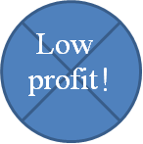
Pomegranate in India today
Today and Tomorrow with Ariel Global
Big fruit
High quality
Beautiful & Attractive
High yield
High technology in all levels of process
Small size fruit
High rate of damaged fruit
Rough and unattractive peal
Low yield
Outdated ways for fruit handlings
With Ariel Global projects

Slide 16
Business Model
Signature of an agreement
Start a project
Panting
Signature MOU
Tests Soil, water & weather.
Ordering planting.
Preparation of land for planting.
Planning of irrigation system
Installation of irrigation system
Planting.
Our company is Guarantee for 70% of fruit buy back

Slide 17
HYDROPONIC - NFT SYSTEM
Plant metabolism researchers have found that the nutrients that plants absorb are simple ions in water. Under natural conditions, the soil is actually the nutrient reservoir, but the soil itself is not essential for plant growth. With the help of the roots, the plants can absorb the nutrients in the soil when dissolved in water. When the nutrients needed for the plant are artificially added to the plant's irrigation water, the plant does not need a rich soil substrate to exist.
Almost any plant can be grown with hydroponics, but some plants are better suited to it than others
These are two main uses for hydroponics. First, it allows to create a controlled plant growing environment, removing many variables from scientific experiments. Second, many plant species produce more output in less time, and sometimes of higher quality; This makes hydroponics a profitable tool for farmers in various economic and environmental conditions. When hydroponics is used, there are no diseases that come from the soil, wild plants to be eliminated, or soil to cultivate. Plants can be grown very densely, saving space (you can even grow plants on several floors). Hydroponics are also economical in water if the containers in which the plants are grown use a closed water system that recycles water. Such systems consume minimal water as compared to traditional agriculture.
Moreover, hydroponic systems are often used as a solution for vertical gardening, when plants need to be grown above each other.

Slide 18
Advantages
The leading technique as an optimal growing method is hydroponics, growing plants directly in water or alternatively in a detached substrate without using any soil at all!
No soil is needed
Water remains in the system and can be reused - significant water savings.
Nutrition and fertilizer levels can be controlled - lower fertilization costs.
There is no ecological and environmental pollution due to the controlled system.
Stable and high yields
Pest and disease treatment are simpler compared to soil growth due to container mobility. No damage from dangerous pesticides.
Weaknesses
Hydroponic growing systems are sensitive to power failure. The pumps that provide the nutritional solution to plants need to be turned on. During a power outage there is a danger of rapid drying of the plant roots.
High initial expenditure compared to growing land.

Slide 19
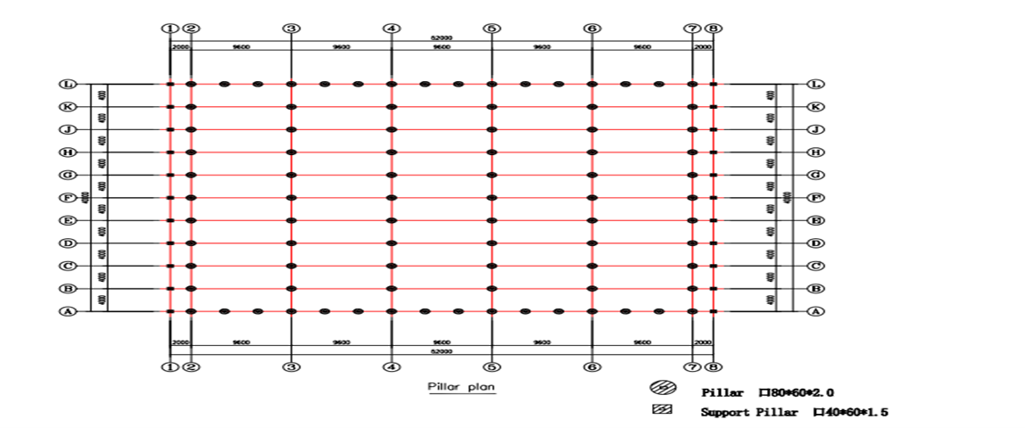
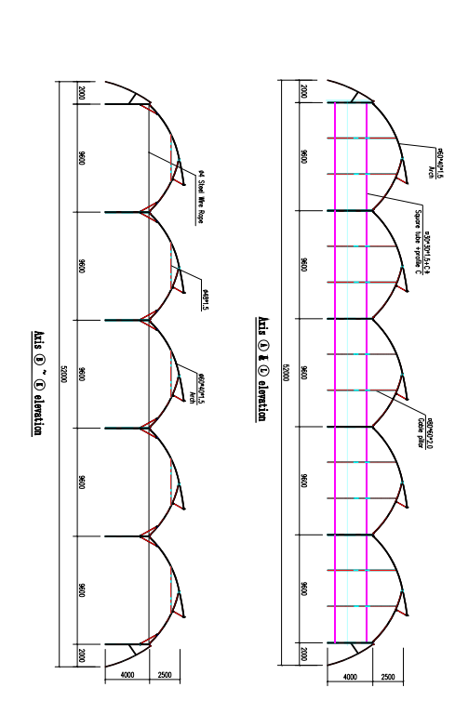
The Greenhouse
The greenhouse is designed exactly for the needs of these types of crops, with advanced ventilation technology and light scattering throughout the growing area

Slide 20
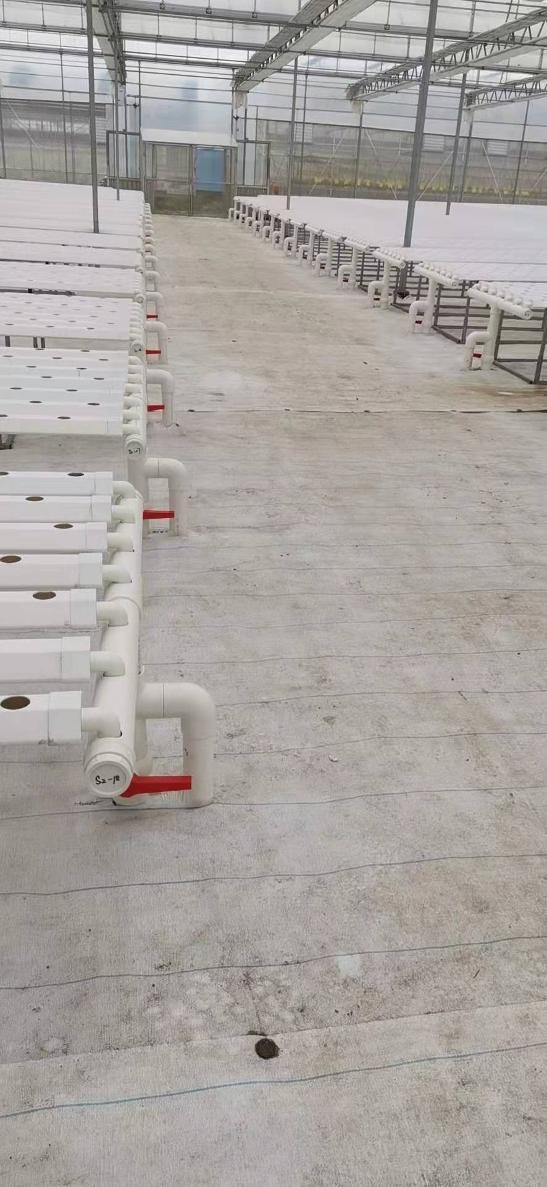
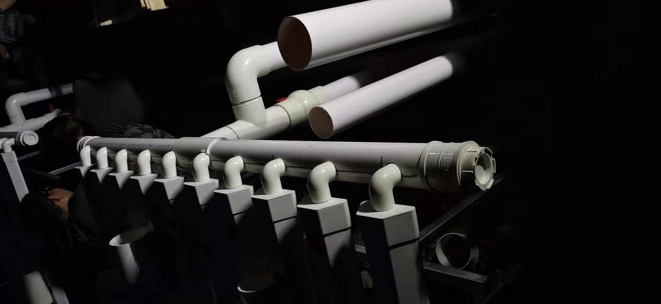

Slide 21
Our Team
Gabriel Talker
Samson Talker
Yigal Menachemy
Pavel Pavlov
Nikita Fedotov
Avinash Jactab
Funder and Director
CEO
Director of Business Development Affairs
Chief Project Manager
Manager of the Israeli farm
Supervisor
project operator in India

Slide 22
Thank You
Gabriel Talker
+972-52-7476779
gabi@arielglobal.co ; samson@arielglobal.co
www.arielglobal.co

